Slide 1
R5SEBA Superscalar Engine and Binary Architecture
EECS 470 Final Project
Presented by
Luke Brzozowski Tong Sing Wu Mahdi Chowdhury
Bureir Alaboudi Michael Kang
April 22, 2025
Notes:
15sec

Slide 2
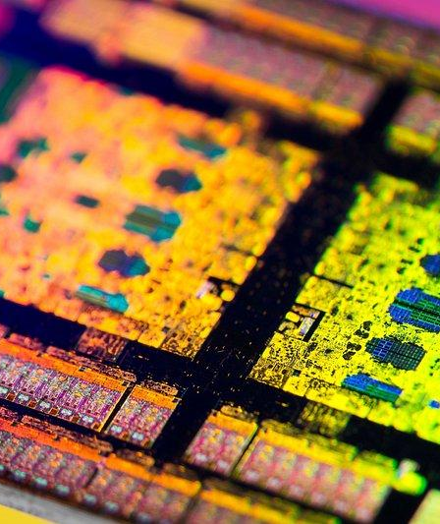
Advanced Features & Unique Implementations
R10K, 2-Way Superscalar
Early Tag Broadcasting
Load Store Queue
Wb D-Cache
Cache Buffer
Store Pipeline in Store Queue
FIFO Everywhere! (Multiple Designs)
Freelist Implementation
Reservation Station without Psel
Rotating Priority Selector with Load priority

Slide 3

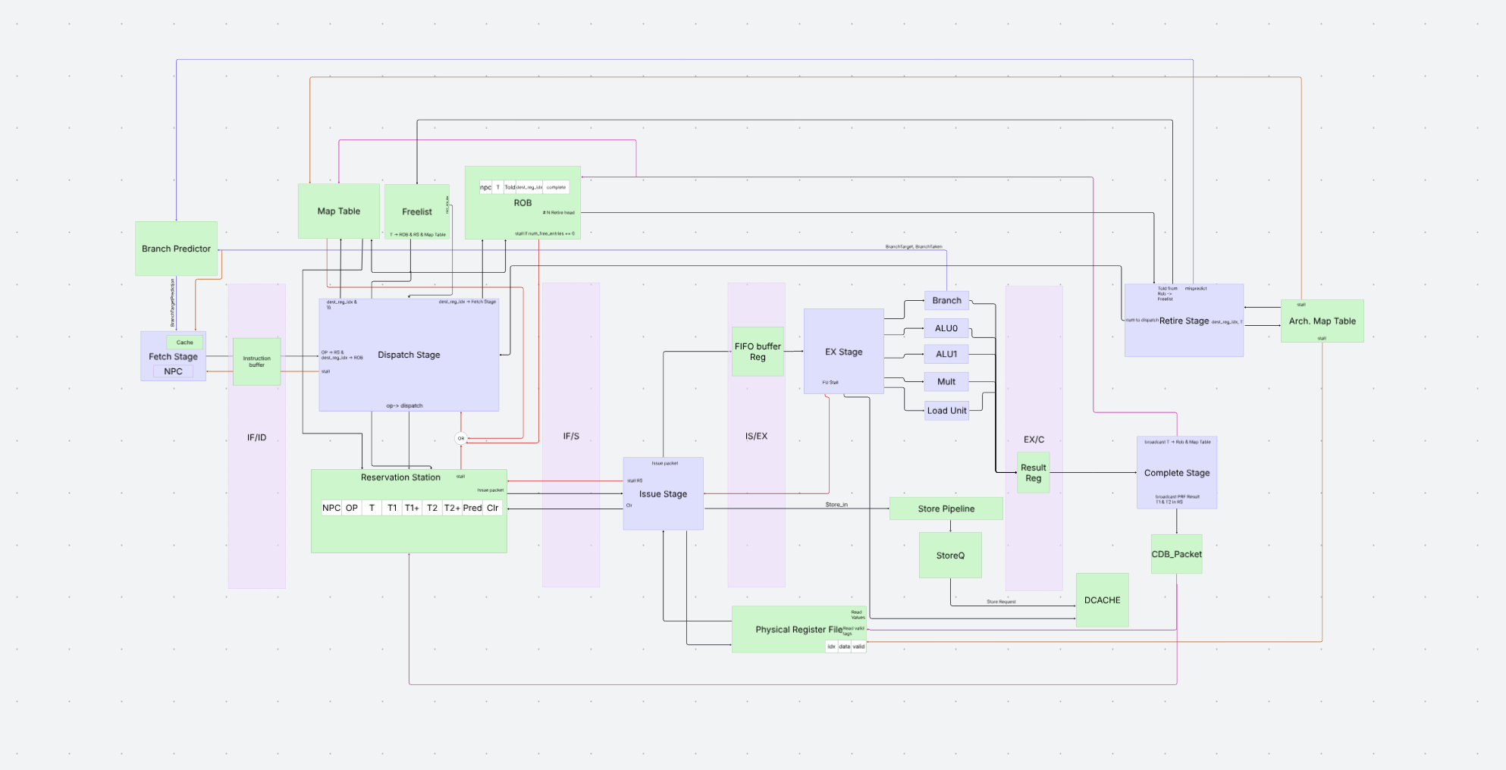
R10K Architectural Map
Notes:
mahdi

Slide 4
FIFO Everywhere!
Cache Buffer (FIFO)
Assigns memory requests and transaction tags
Handles back pressure from multiple memory requests efficiently
Issue Buffers (FIFO), per Functional Unit (Load, Store, Mult, ALU, and Branch)
Each queue supports 2 functional units for high parallelism
Acts as a extension to the RS that handles the CDB backpressure
Instruction Buffer (FIFO)
Handles back pressure when a structural hazard occurs
Also:
ROB (FIFO)
LSQ (FIFO) (Has its own slide)
Freelist (FIFO) (Has its own slide)
Notes:
michael

Slide 5
Reservation Station Without Priority Selector
Multi Issue Support
Supports 2 dispatches and 2 issues per cycle.
Memory Dependency Tracking:
Uses UncStatus flag to stall loads until older store retires
Backpressure Handling
Checks FU FIFO before issuing to prevent stalls.
Notes:
Uncstatus integrates memory op tracking directly into the RS.
Other than the normal rs features
Determining if individual FIFOs need to stall
Mahdi

Slide 6
Early Tag Broadcast
Have early tag broadcasting for all instructions except load and store
Arbitrate on the Issue FU FIFO, because it’s an extension of the RS. The head and next head of the FIFO acts as the issue register that is arbitrated on
This design is unique because this means we don’t get information to arbitrate from the RS so all processing for ETB is unified in Issue Stage
Notes:
30 seconds
We were late to the 2nd milestone and were not able to complete the test on time.
Our current assessment indicates that while completing the processor is still feasible, it requires substantial effort and commitment. Perhaps more than we are currently contemplating.
The current state of progress demonstrates that the meaningful advancement cannot occur without significant changes in team management.
Increased time allocation and effort will benefit our progress, but the issue remains between collaborative team attention and teamwork resolution.

Slide 7
Load Store Queue
Data Forwarding Support
Built-in support for data forwarding, but currently not enabled
Optimal Load/Store Coordination
Load and stores are managed with a design that eliminates arbitration, so they don’t fight for shared resources
Early Coordination
Loads and stores coordinate directly with the Reorder Buffer (ROB) and Reservation Stations (RS) as early as possible, reducing latency and improving efficiency
Notes:
30 seconds
Mahdi
We were late to the 2nd milestone and were not able to complete the test on time.
Our current assessment indicates that while completing the processor is still feasible, it requires substantial effort and commitment. Perhaps more than we are currently contemplating.
The current state of progress demonstrates that the meaningful advancement cannot occur without significant changes in team management.
Increased time allocation and effort will benefit our progress, but the issue remains between collaborative team attention and teamwork resolution.

Slide 8
Store Queue Pipeline
Divergent Store Pipeline
Stores are routed through a separate pipeline, so they don’t compete with other instructions for execution resources. This keeps the main pipeline less congested.
Simple Adder for Store Address Calculation
We use a dedicated adder to compute store addresses instead of relying on the ALU. This design avoids ALU bottlenecks (with multiplies) and can shorten store operations by collapsing two cycles into one.
Matched Store Queue (SQ) & Reorder Buffer (ROB) Sizes
By keeping the SQ and ROB the same size, the store pipeline maintains a steady flow with no risk of stalls due to resource limitations.
Notes:
30 seconds
Mahdi
We were late to the 2nd milestone and were not able to complete the test on time.
Our current assessment indicates that while completing the processor is still feasible, it requires substantial effort and commitment. Perhaps more than we are currently contemplating.
The current state of progress demonstrates that the meaningful advancement cannot occur without significant changes in team management.
Increased time allocation and effort will benefit our progress, but the issue remains between collaborative team attention and teamwork resolution.

Slide 9
Rotating Priority Selector
Rotating PSEL with Load Priority
We use a rotating priority selector (PSEL) with hard-coded load priority to ensure loads are always taken care of to avoid starving other instructions.
Stores don’t use this pipeline, avoiding unnecessary resource usage
Parallel Completion with Execute
The complete stage operates in parallel with the execute stage, which shortens the critical path and allows timing optimizations by decoupling these processes.
Notes:
30 seconds
Mahdi
We were late to the 2nd milestone and were not able to complete the test on time.
Our current assessment indicates that while completing the processor is still feasible, it requires substantial effort and commitment. Perhaps more than we are currently contemplating.
The current state of progress demonstrates that the meaningful advancement cannot occur without significant changes in team management.
Increased time allocation and effort will benefit our progress, but the issue remains between collaborative team attention and teamwork resolution.

Slide 10
Freelist Implementation
Freelist as a FIFO
Allocates and recycles tags for register renaming using FIFO logic
Head pointer: Dispatches (reads) new tags for instructions entering the pipeline
Tail pointer: Recycles (writes) tags from retiring instructions
Branch Misprediction Recovery
On misprediction, freelist recovery is instant—tail pointer is set back to the head and size is reset
Head → Tail: Free tags (retired instructions)
Tail → Head: Tags held by instructions still in flight
Notes:
30 seconds
Mahdi
We were late to the 2nd milestone and were not able to complete the test on time.
Our current assessment indicates that while completing the processor is still feasible, it requires substantial effort and commitment. Perhaps more than we are currently contemplating.
The current state of progress demonstrates that the meaningful advancement cannot occur without significant changes in team management.
Increased time allocation and effort will benefit our progress, but the issue remains between collaborative team attention and teamwork resolution.

Slide 11
Performance Analysis & Possible Optimization
Clock Period: 12.87 ns
CPI: 4.96 (On Given Test Cases)
Critical Path:
ROB Retire → Store Queue Retire → DCache
*https://latamfdi.com/semiconductor-industry-in-the-dominican-republic/

Slide 12
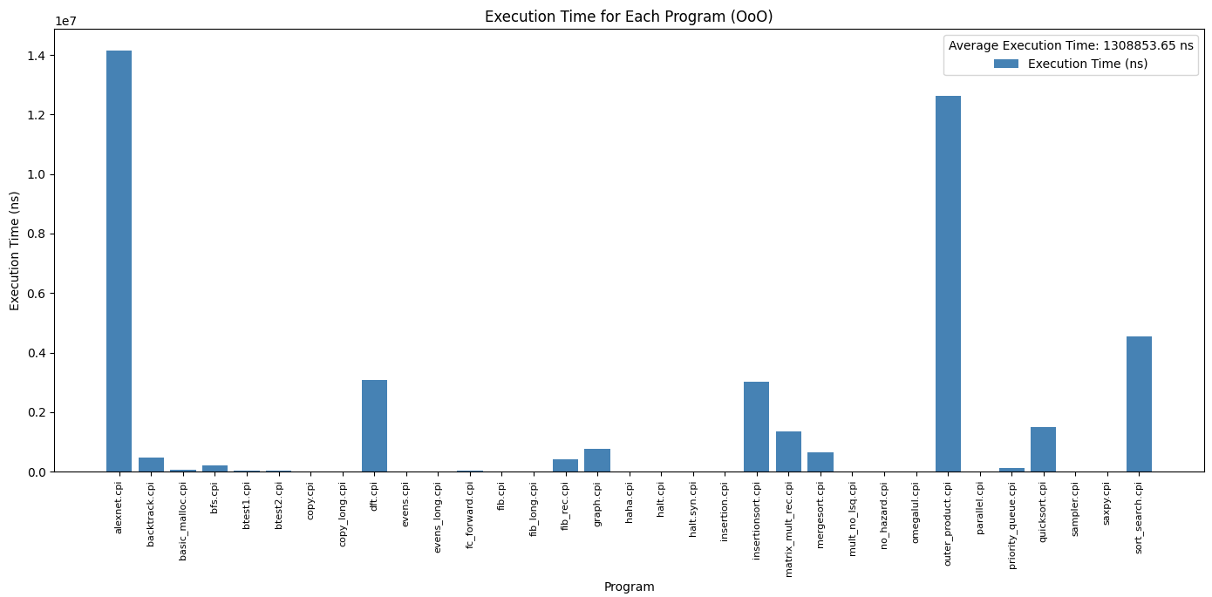
Performance Analysis: Execution Time
Notes:
30 seconds
Mahdi
We were late to the 2nd milestone and were not able to complete the test on time.
Our current assessment indicates that while completing the processor is still feasible, it requires substantial effort and commitment. Perhaps more than we are currently contemplating.
The current state of progress demonstrates that the meaningful advancement cannot occur without significant changes in team management.
Increased time allocation and effort will benefit our progress, but the issue remains between collaborative team attention and teamwork resolution.

Slide 13
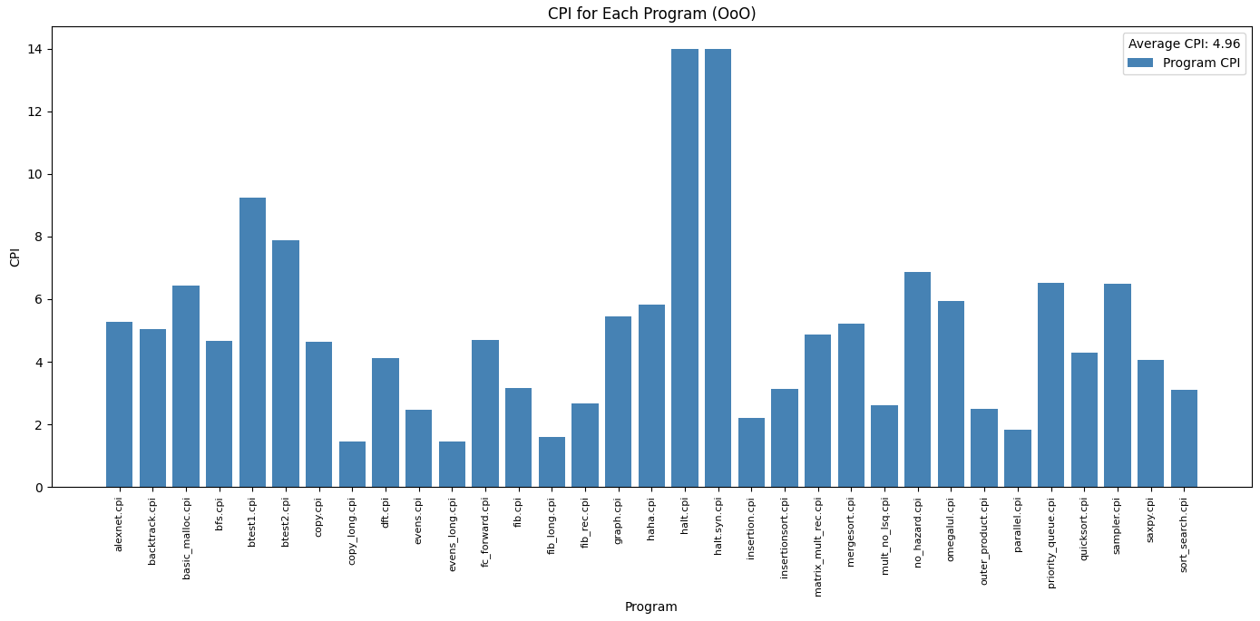
Performance Analysis: CPI
Notes:
30 seconds
Mahdi
We were late to the 2nd milestone and were not able to complete the test on time.
Our current assessment indicates that while completing the processor is still feasible, it requires substantial effort and commitment. Perhaps more than we are currently contemplating.
The current state of progress demonstrates that the meaningful advancement cannot occur without significant changes in team management.
Increased time allocation and effort will benefit our progress, but the issue remains between collaborative team attention and teamwork resolution.

Slide 14
Bottlenecks & Critical Path
Critical Path: ROB Retirement to Store Queue
When the ROB retires a store, the store queue must also retire the corresponding entry
The retiring store triggers a request to the data cache (dcache)
Must compare the retiring instruction with others (e.g., next store, JALR, branch) to ensure proper ordering and detect hazards
Misprediction Complexity:
If a misprediction is detected (mispeculated branch), all inflight instructions and the store queue must be squashed
This adds logic and timing pressure to the control path, increasing latency
Multiplier Pipeline:
4-stage multiplier intended for high throughput, but the critical path (above) overshadows the potential CPI gains
Result: CPI is still higher than expected, despite pipelining

Slide 15
Possible Optimizations
2-Stage Multiplier
Implementing a 2-stage multiplier allows for a 13 ns clock period
Reduces latency without increasing CPI
Store Pipeline Simplification
Collapse the unique store pipeline stage
Register store queue output for dcache access in the next cycle
Preserves CPI and significantly reduces clock period
Control & FIFO Improvements
Add support for more functional units per FIFO (if not already two)
Enhanced Data Forwarding
Expand data forwarding support beyond current partial implementation
Minimizes stalls and improves overall throughput

Slide 16
Development Methodologies & Testing
Iterative and adaptive design process
Comprehensive testing at module level
Focus on synthesis and validation of hardware
*https://latamfdi.com/semiconductor-industry-in-the-dominican-republic/

Slide 17
Iterative Development & Testing
Agile Development (At First)
Emphasized adaptability, frequent check-ins, and incremental progress
Spiral Development (post-Spring Break)
Switched to a cyclical approach: planning, prototyping, testing, and refining in repeated loops
Unit & Integration Testing
Tested individual modules in isolation to catch bugs early
Combined modules and verified their interactions worked correctly
Fake Fetch
Used a fake fetch module early on to simulate instruction flow before the full cpu.sv was ready
Notes:
michael

Slide 18
Validation and Synthesis Readiness
Regression Testing
After each change, re-ran previous tests to ensure we didn’t break existing functionality
Synthesis Testing
Used cpu_synth.out and cpu.rep to check real-world synthesis results
Debugged timing loops and latch issues to ensure design could be implemented on hardware
Continuous Improvement
Regularly incorporated test results and synthesis feedback into our development cycle
Notes:
Mahdi
Vapor view
Diff checker
Timing loop in rep

Slide 19
Challenges & Takeaways
Initial difficulties starting off
Crunching to meet deadlines
Bringing it back to finish strong

Slide 20
Challenges & Difficulties
Late Start
We began the project later than ideal, requiring extra effort and long hours to meet deadlines
Team Changes
During the middle of the semester, we unfortunately had a group member drop, which scattered priorities and we had to have time to adjust for workflow
Scheduling Struggles In Person
At the beginning of the project, it was hard to coordinate meeting times. A lot of the time we relied heavily on working together, but ended up online.
Team Dynamics
Initial difficulties with team dynamics and communication as we learned to collaborate effectively
Notes:
luke

Slide 21
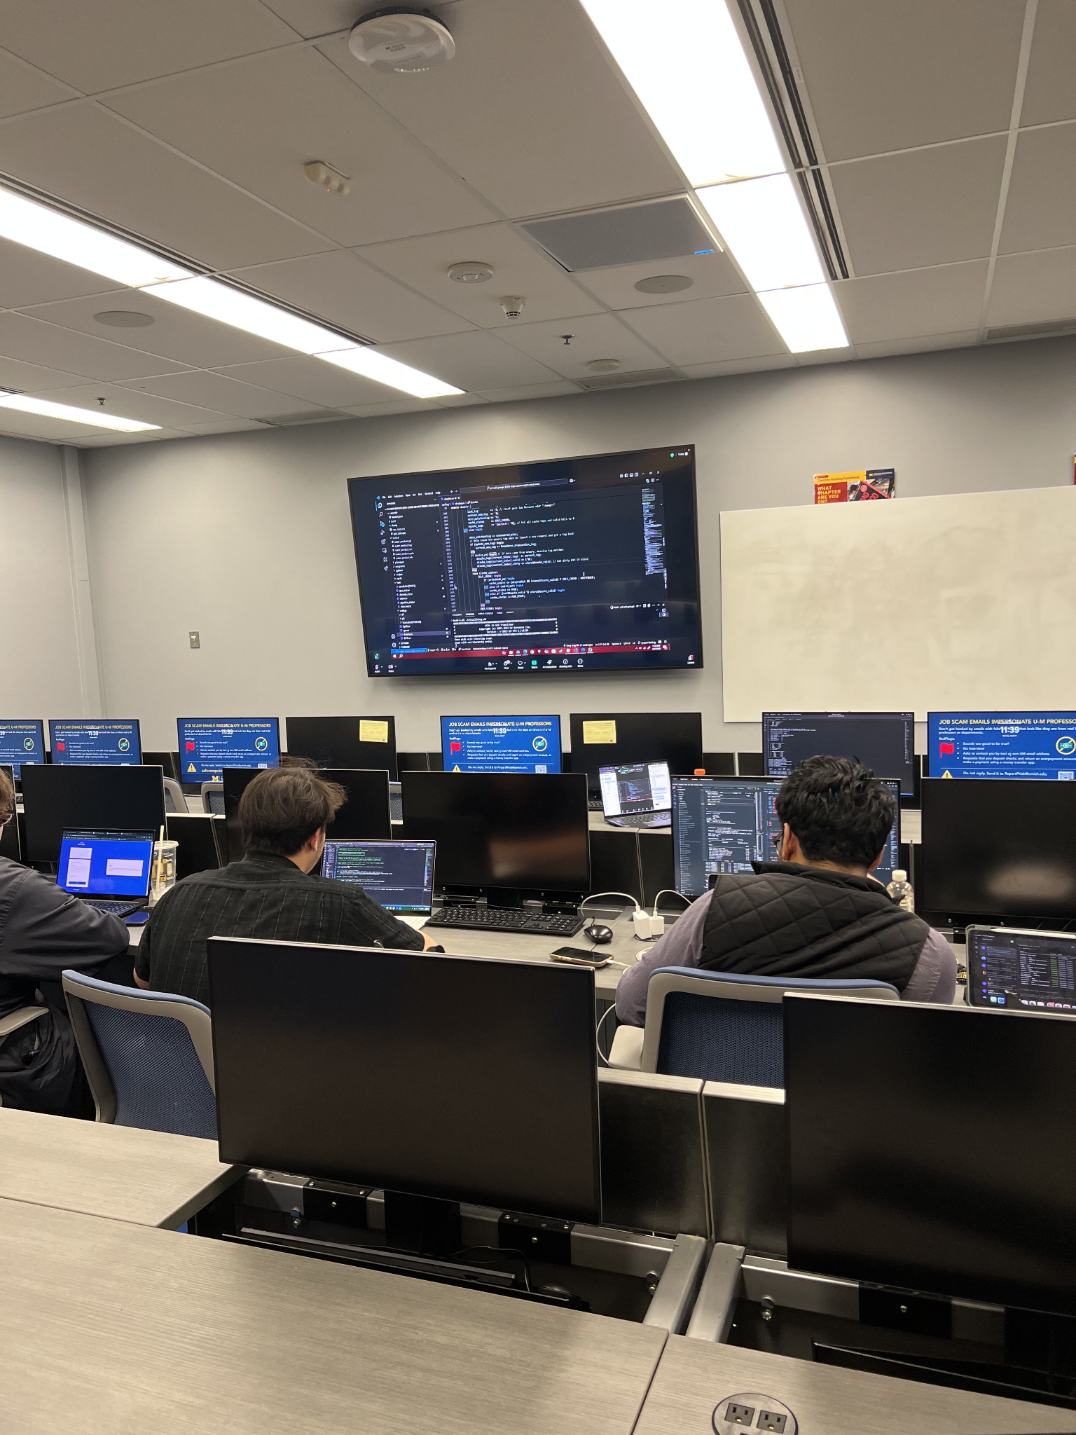

Takeaways & Learned Learned
Planning before you code
Mapping out to how implement features before jumping in saves time and reduces debugging hours
Everything takes 2x time than we thought
Implementation and debugging usually takes twice as long as you expect it does
Reach out for help!
If you’re struggling with an issue or having a hard time starting, then reaching out for help to the staff is such a huge help.
Make sure to start early!
Since we didn’t start early, we were constantly playing catch-up till the end of the semester.
Remember to leave time to synthesize
(11:39pm in BBB yesterday)
Notes:
Michael

Slide 22
THANK YOU!
QUESTIONS?

